Slide 1
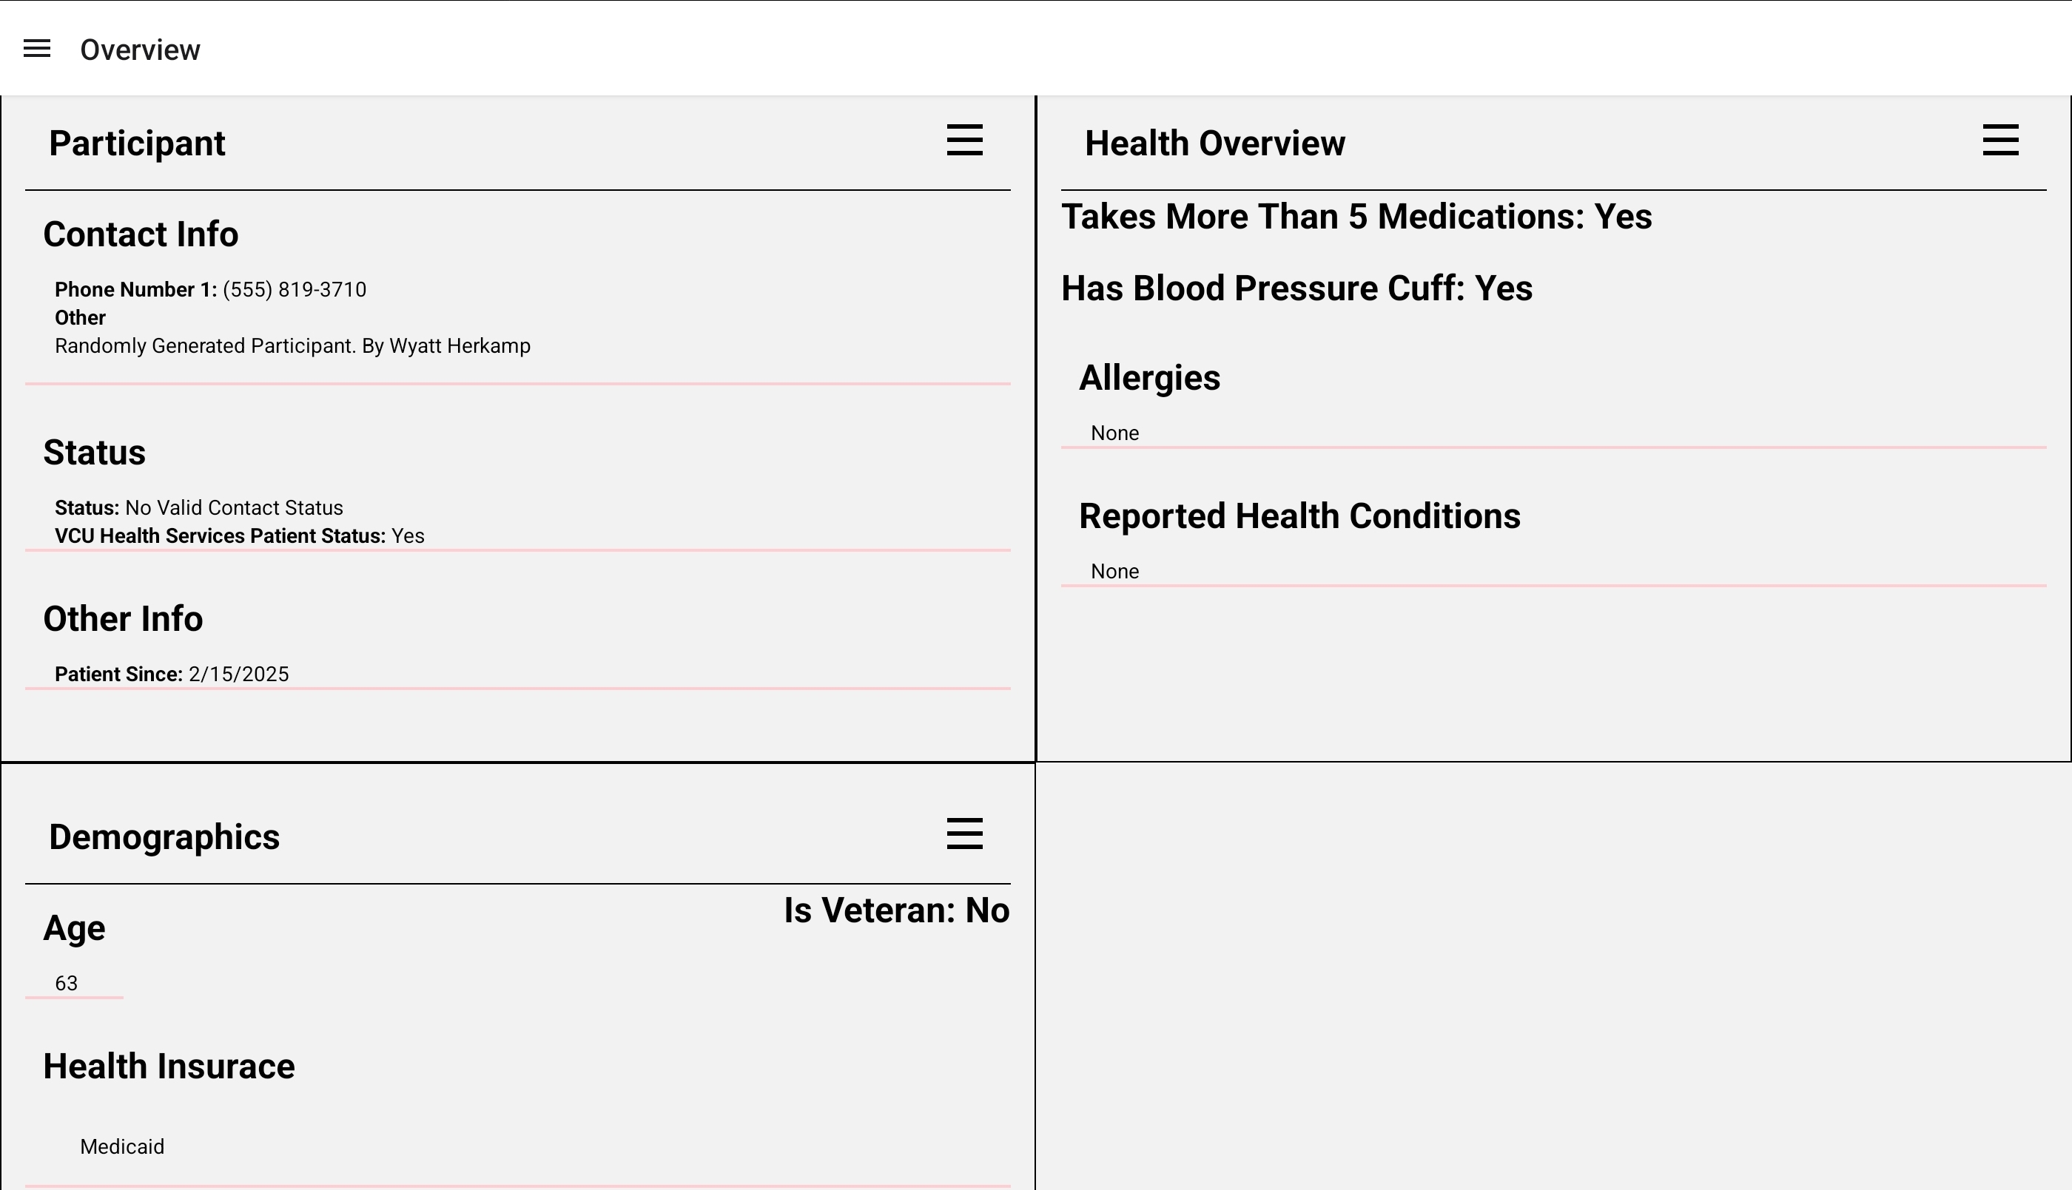
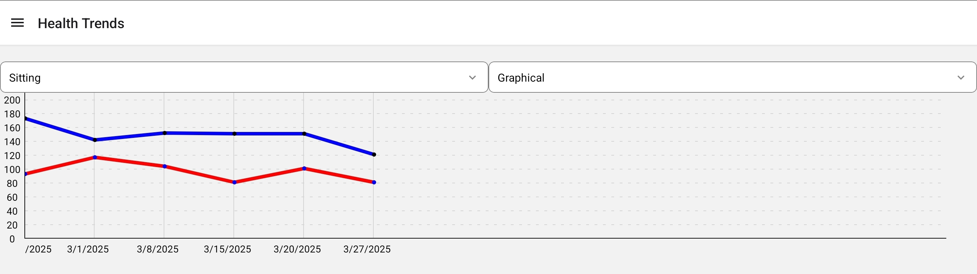
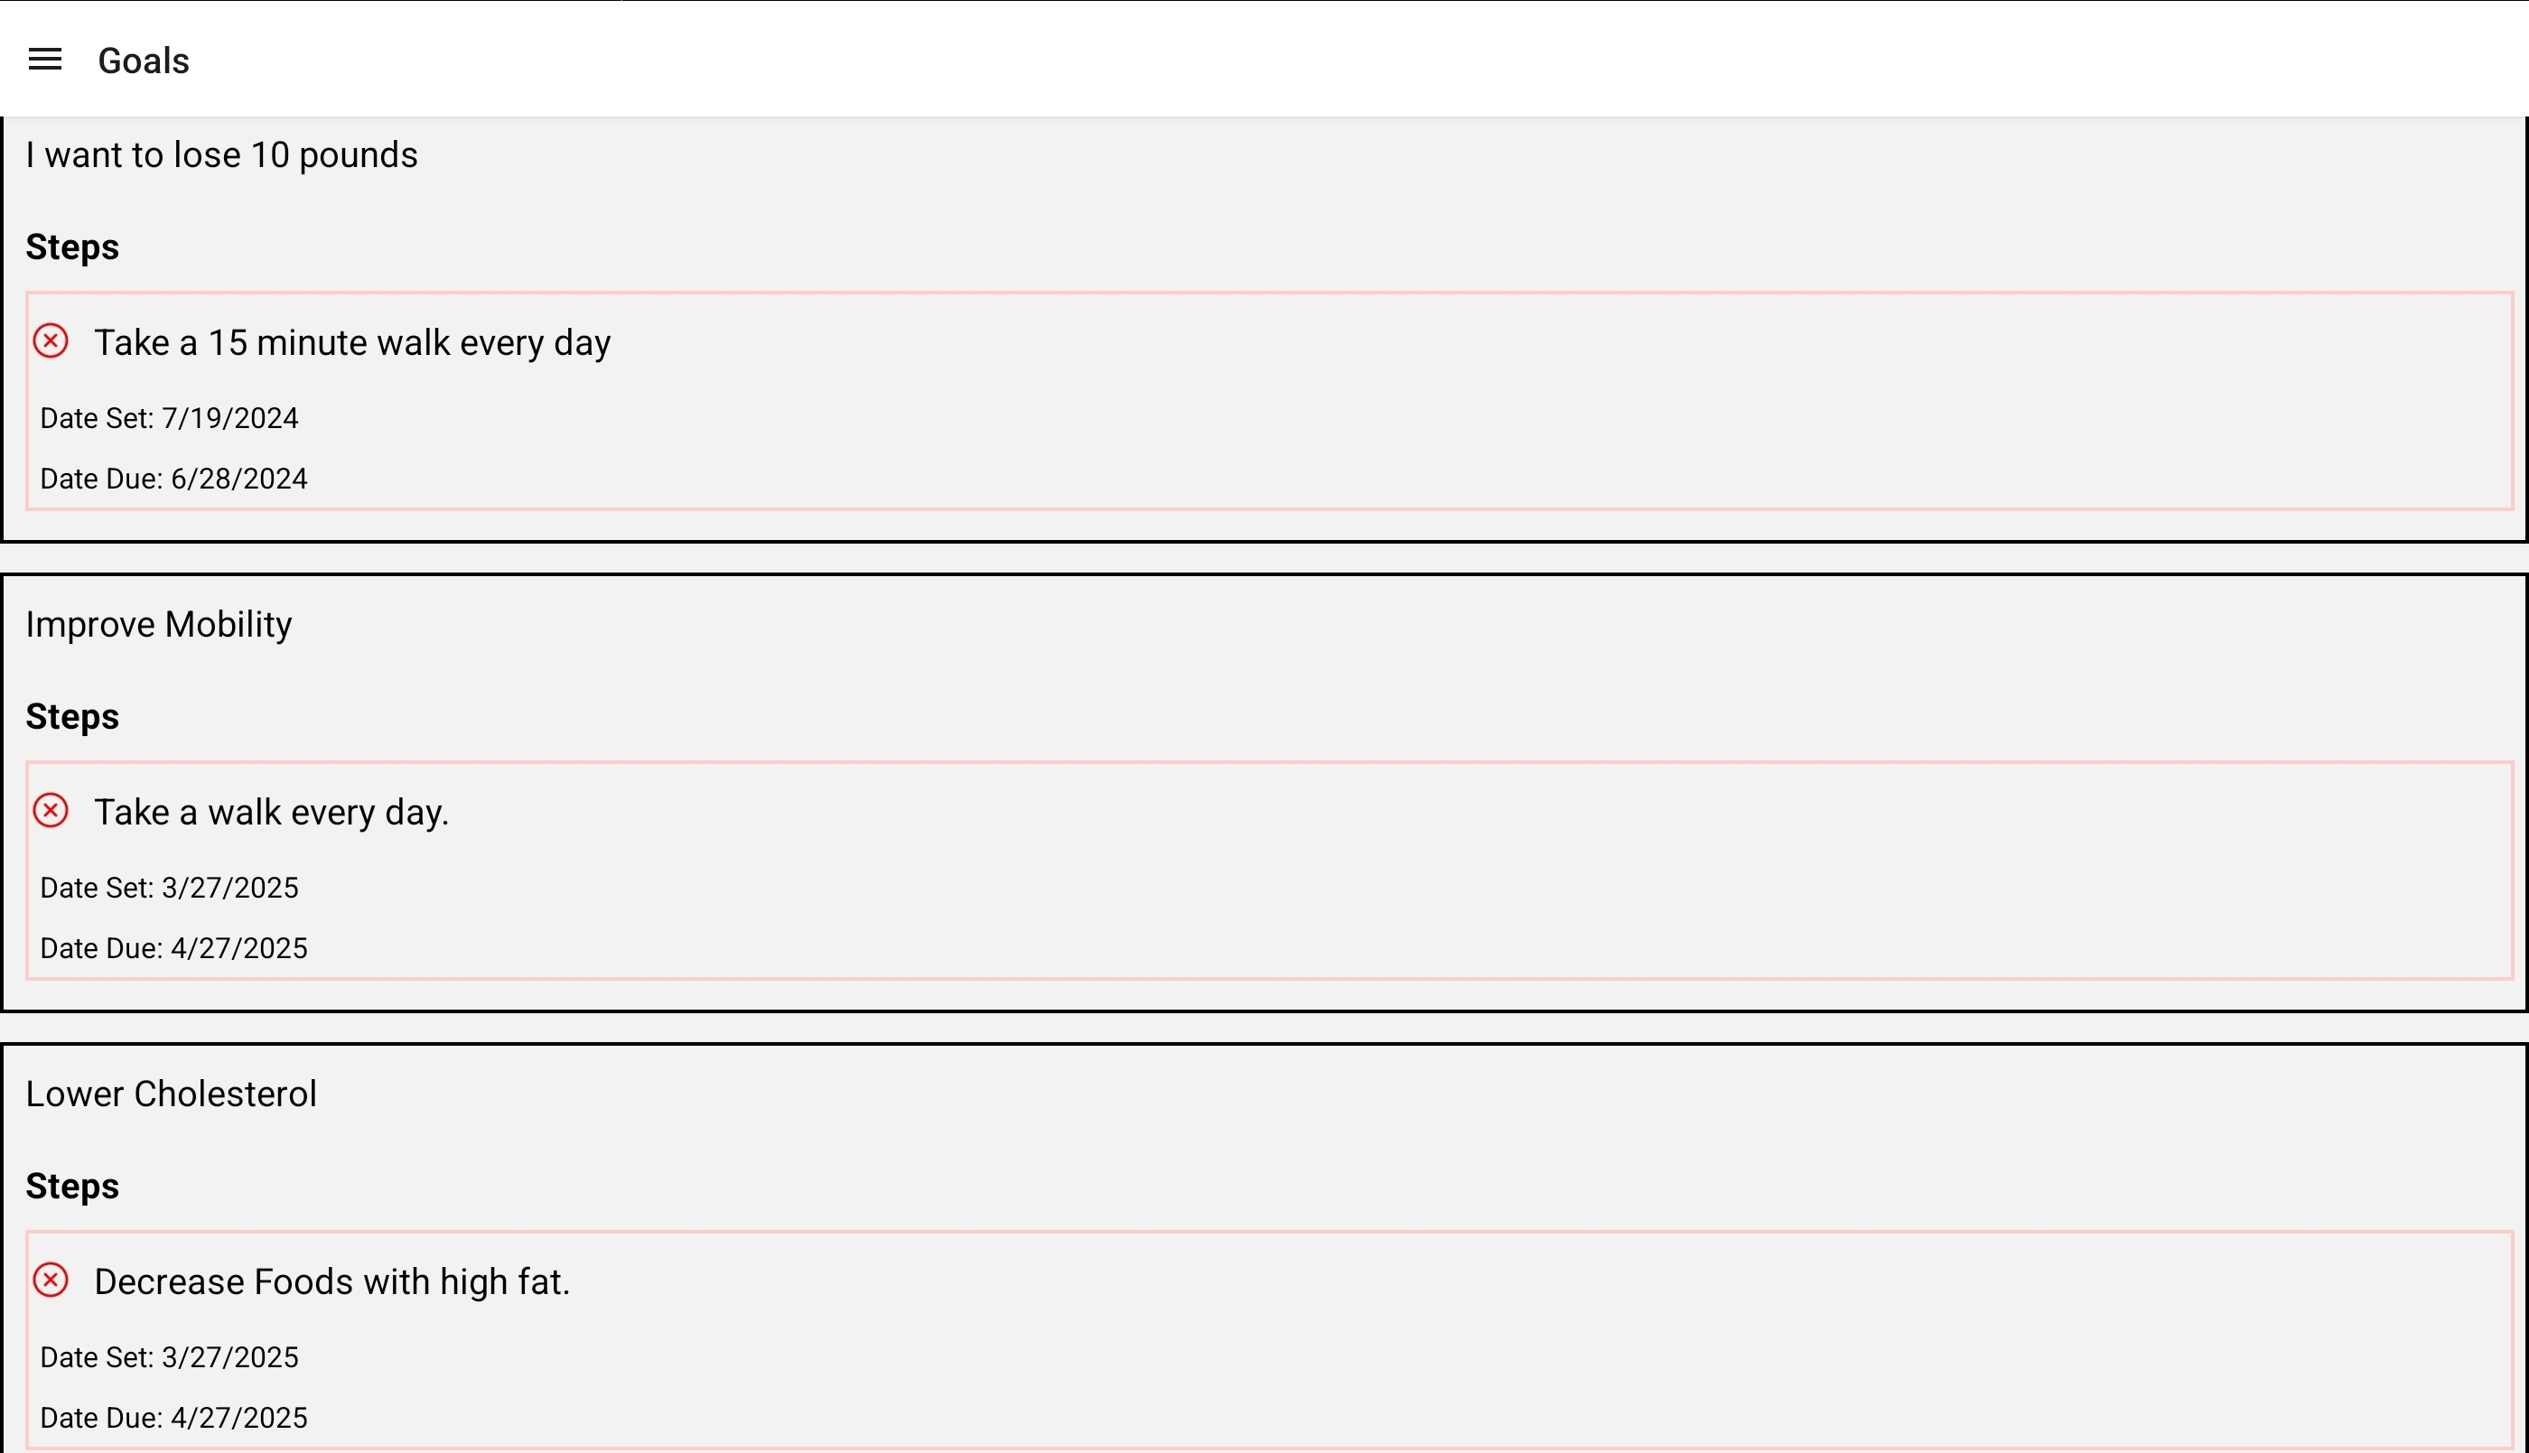
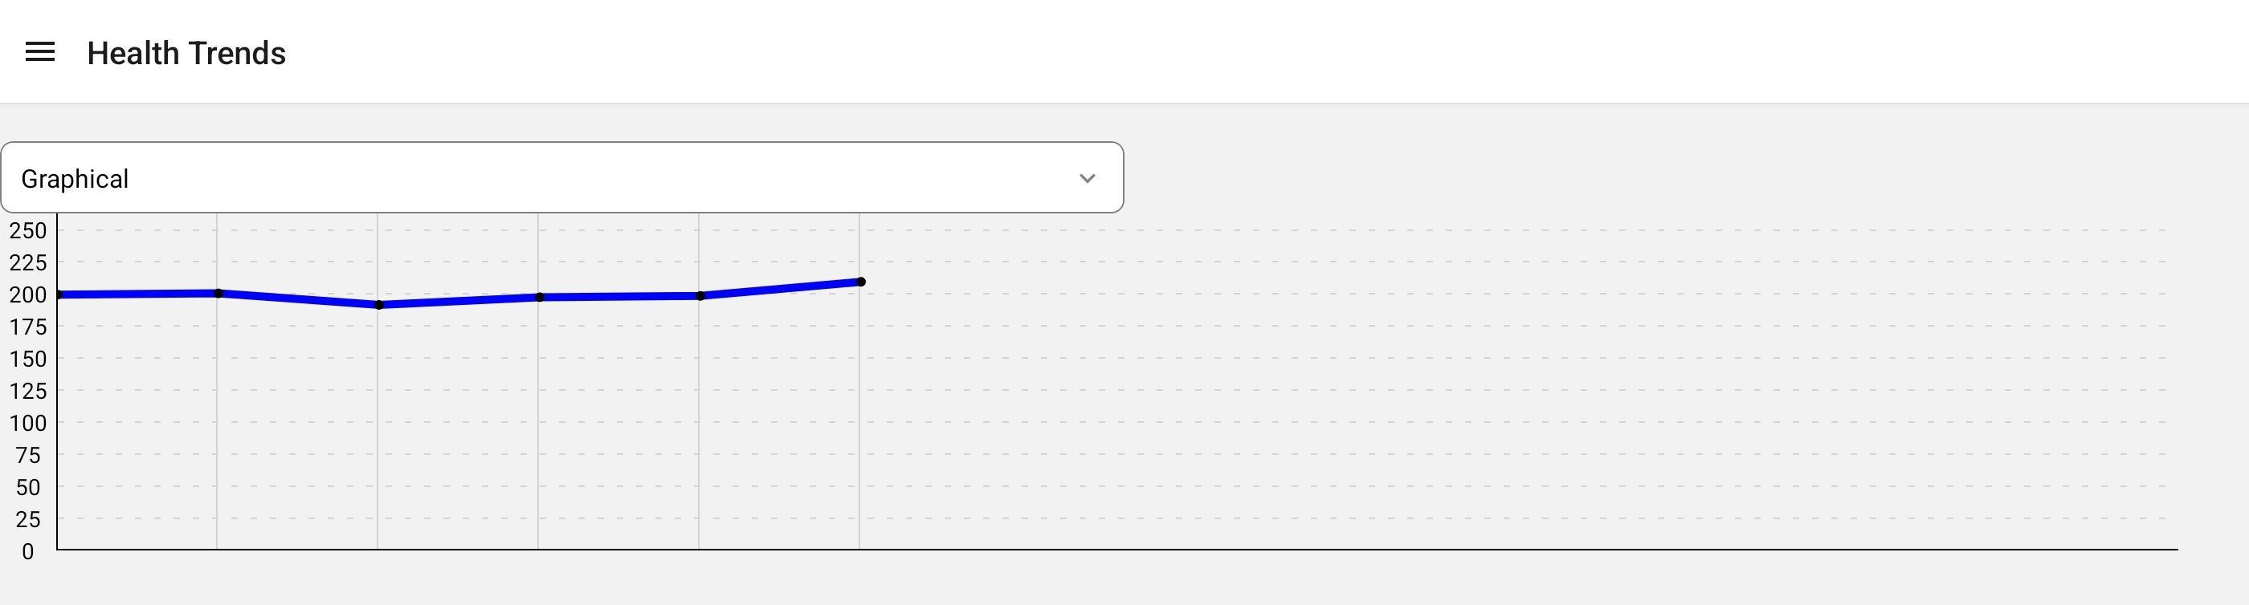
25-303
Tablet-based Application For Clinicians
Team members: Tyree Carpenter, Shikriti Ghosh, Ebenezer Hailu, and Wyatt Herkamp | Faculty adviser: John Leonard Ph.D. | Sponsor: VCU School of Nursing | Mentor: Jered Wendte
Problem Statement
The Design
Technical Process
Create and document a prototype for a tablet app that helps clinicians review past survey responses before patient meetings, enhancing their preparation.
This database design is based on the previously existing RedCap System that is being utilized by the MHWP currently, with changes to ensure for interoperability & future scalability as well. We have made some changes that allow for more consistent data, while at the same time entirely mapping to the forms that the clinicians are already accustomed to interacting with. Also, by making a full mapping of the data that already exists in the database, it has allowed us to broaden the scope of possibilities to allow for editing of participant data in real time. This system that backend has been design in such a way that allowed for Researchers and Participants groups to also use this backend.
Expected Impact
This project aims to improve the efficiency and quality of care in the MHWP by providing clinicians with swift access to accurate participant information. This will help prevent data loss, reduce delays, and ensure consistent care with varying clinicians, ultimately enhancing participant outcomes and clinician workflow in mobile healthcare.
Blood Pressure Trends
Monitoring Goals
Future Considerations
Our current design has significantly expanded the possibilities for the Mobile Health and Wellness Program. It facilitates advanced research using data from RedCap and supports the development of mobile apps that streamline data entry for clinicians. Moreover, the backend design of our system enhances participant interactions and enriches the overall experience for clinicians.
Weight Trends

